Slide 1
Analysing British Airways Reviews
The coding implementation and analysis are completed via Jupyter Notebooks by Kirisan Thiruchelvam. You may access the project here.

Slide 2
Collecting and Pre-Processing Reviews
Deployed Python libraries such as BeautifulSoup to collect and parse HTML data into a text format
In total, I collected 1000 reviews from AirlineQuality.com
Removed unnecessary details such as ”Trip Verified” and messages that are not relevant to our analysis.

Slide 3
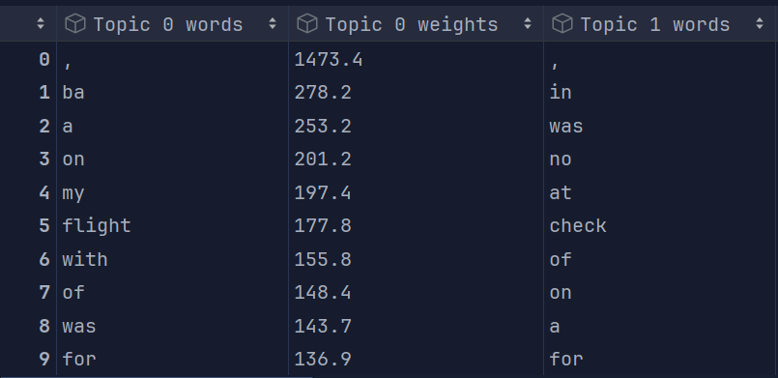
Topic Modelling
Utilised sklearn’s CountVectorizer to transform the reviews and get a frequency distribution of words used within the reviews.
Sklearn’s LatentDirichletAllocation Model was fitted with this data.
Analysis reveals that common words include ‘BA’ with a topic weight of 278.2, an abbreviation for British Airways. Additionally ‘no’, ‘not’ is also a common word with a topic weight of 291.2 and 323.5 amongst the reviews collected. This can suggest British Airways has missed something when providing their services.

Slide 4
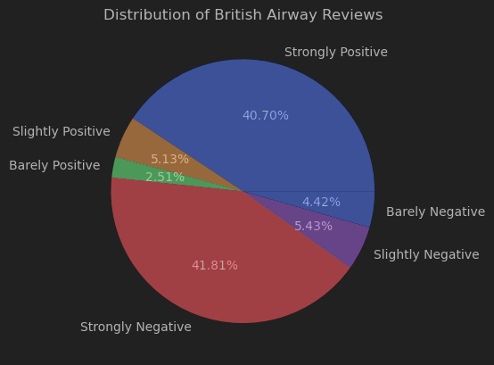
Sentiment Analysis
Deployed NLTK’s pre-trained SentimentIntensityAnalyzer also known as VADER. Valence Aware Dictionary and sEntiment Reasoner.
Applied this model to all the reviews gathered, obtaining a distribution of Strongly Positive, Strongly Negative, Slightly Positive and more.
This distribution is demonstrated visually in the form of a pie chart.

Slide 5
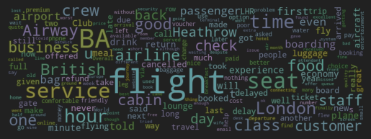
Word Cloud
Constructed a WordCloud using the WordCloud Library
Excluded StopWords – words which do not provide actual meaning such as prepositions
Attempted to make the WordCloud take shape of an Aeroplane using a mask and np array representing an image of an aeroplane.
WordCloud demonstrates that the most popular words are BA, flight, good, food, service, British

Slide 6
Thank you for this opportunity!
LinkedIn:
https://www.linkedin.com/in/kirisant/
Please see my other projects here:
https://github.com/kkpro18/
Contact Email: Kirisan.thiru@gmail.com

